Slide 1
Independent Study of Machine Learning Explainability
By Nicholas Stepanov
Mentor: Prof. D. Petkovic
Fall 2018
San Francisco State University

Slide 2
Project Goals
Compare the performance of two machine learning models: Random Forest classifier and Support Vector Machine using accuracy metrics widely used in industry setting.
Provide some insight to explainability of the derived models presenting intuitive explanations to how the predictions are made and what are the most important prediction features in used databases.
Two distinct Databases are taken from UCI Machine Learning Repository and are publicly available for use.

Slide 3
Random Forest Classifier
Random Forest Classifier was chosen as first machine learning technique which is a powerful tool in analysing big data showing significant results in various applications
Random Forest is a technique that utilizes Decision Tree Statistical Learning and improves it using ensemble method. Multiple Decision Trees are combined to arrive to an overall prediction.
In the process of training the data is bootstrapped into groups and each Decision Tree in the forest is trained on its own data. The bootstrapped data points are drawn with replacement making each Decision Tree to be trained on a separate training set. Once the training is complete, the overall outcome is determined based on the amount of class predictions of individual trees.
From [6]

Slide 4
Random Forest Parameters and Optimization
Tuned parameters:
NTREE - number of trees generated during bootstrapping process
MTRY - number of features that are randomly selected with replacement in each Decision Tree that are evaluated to determine the best split on the data.
CUTOFF - the proportion of Decision Trees that need to vote for positive predictions in the forest to generate an overall positive prediction
Random Forest utilizes Out-Of-Bag error to calculate accuracy. Out-Of-Bag error evaluates predictions skipping data points which were used to train particular Decision Trees. Therefore, the prediction for each data point is determined only based on votes of the trees that did not use this data point during training.[6] Accuracy metrics were then calculated using this OOB error value.
The model was optimized to maximize the ROC Area Under Curve accuracy metric. Multiple RFC models were trained with different parameter values ( MTRY - [sqrt(num_features)/2,sqrt(num_features),2*sqrt(num_features)]; CUTOFF - [0.1 … 0.9]) in a grid search approach. NTREE was chosen as 1000 as largest number of trees to keep the training process reasonably fast. The model with the best Area Under Curve was recorded.

Slide 5
Random Forests Variable Importance Determination
Most important features in the optimized model were selected as the ones that maximize Mean Decrease in Accuracy (MDA).
MDA for a particular feature is determined by permuting the feature value in all the data samples and taking the mean of the decrease in accuracy such permutations produce on all data point predictions. The features that produced largest decrease in accuracy after such permutation are deemed to be more important.
In case of unbalanced class data computation of multiple class specific MDA values is recommended. MDA calculations are provided in R randomForest library function: importance().

Slide 6
Support Vector Machine (SVM)
Support Vector Machine is a powerful Machine Learning technique that aims to split the data into classes based on support vectors.
Support Vector Machines find lowest error (Loss) hyperplane to split the data between two classes.
The data provided to train an SVM needs to be scaled with Median Value of 0 and Standard Deviation of 1. After the weights are optimized to give minimal Loss the predicting class can be determined as follows:
Z_{i} = sgn(w^{T}X_{i} + b)
Loss function that determines amount of data points that are not correctly classified:
Y_{i}Z_{i} ≥ 1 for all i; min 1/2||w||² + C∑ξ_{j} , where ξ_{i} is margin violation parameter
http://cs229.stanford.edu/notes/cs229-notes3.pdf
In this project Linear kernel SVM is used to compare the predicting power to Random Forests.

Slide 7
SVM Parameter Optimization and Variable Importances
The only relevant parameter for optimization in a linear SVM is C which is a cost of misclassification in the loss function.
The higher value of C will mean that the model will be greatly affected by any data that is misclassified, while lower values will cause the model to misclassify more data finding the optimal distance separation hyperplane. C is then optimized to maximize the ROC Area Under Curve score for a randomly selected test dataset compromising of 25% of total data. The values of C used in grid search: [0.001, 0.002154435, 0.004641589, 0.01, 0.021544,0.03125, 0.0625, 0.125, 0.25 0.5, 1., 2., 4., 8., 16., 32.] (These values were advised by Dr. L. Buturovic on Nov. 2018)
Some information relative to variable importances in a linear SVM can be derived from individual feature weights w_{j}. Since the features are all normalized with 0 mean and unit variance, higher absolute values of w_{j} will indicate that j-th feature plays higher role in determining prediction Z. (From Yin-Wen & Chih -Jen [5])

Slide 8
Methods of Comparison
The model performances are compared:
Using same evaluation metric - ROC AUC score.
Two open source Databases were selected and each had both models optimized and performance results compared.
The most important features for each model were derived and compared.

Slide 9
Accuracy Metrics Used
Two commonly used accuracy metrics were considered for this project:
F1_Score - weighted average of model’s precision (ratio of True Positive predictions in all positively labeled data) and recall (ratio of True Positive predictions in all positive predictions).
ROC AUC Score - (Receiver Operating Characteristic Area Under Curve) ROC Curve plots the True Positive Rate and False Positive Rate on a graph as the threshold of classification probability increases from 0 to 1. The graph starts at (0,0) where all data is classified as false and ends at (1,1) where all data is classified as true. The closer the area under resulting graph is to 1 the more accurate is the given model in terms of predicting probability.
https://towardsdatascience.com/understanding-auc-roc-curve-68b2303cc9c5

Slide 10
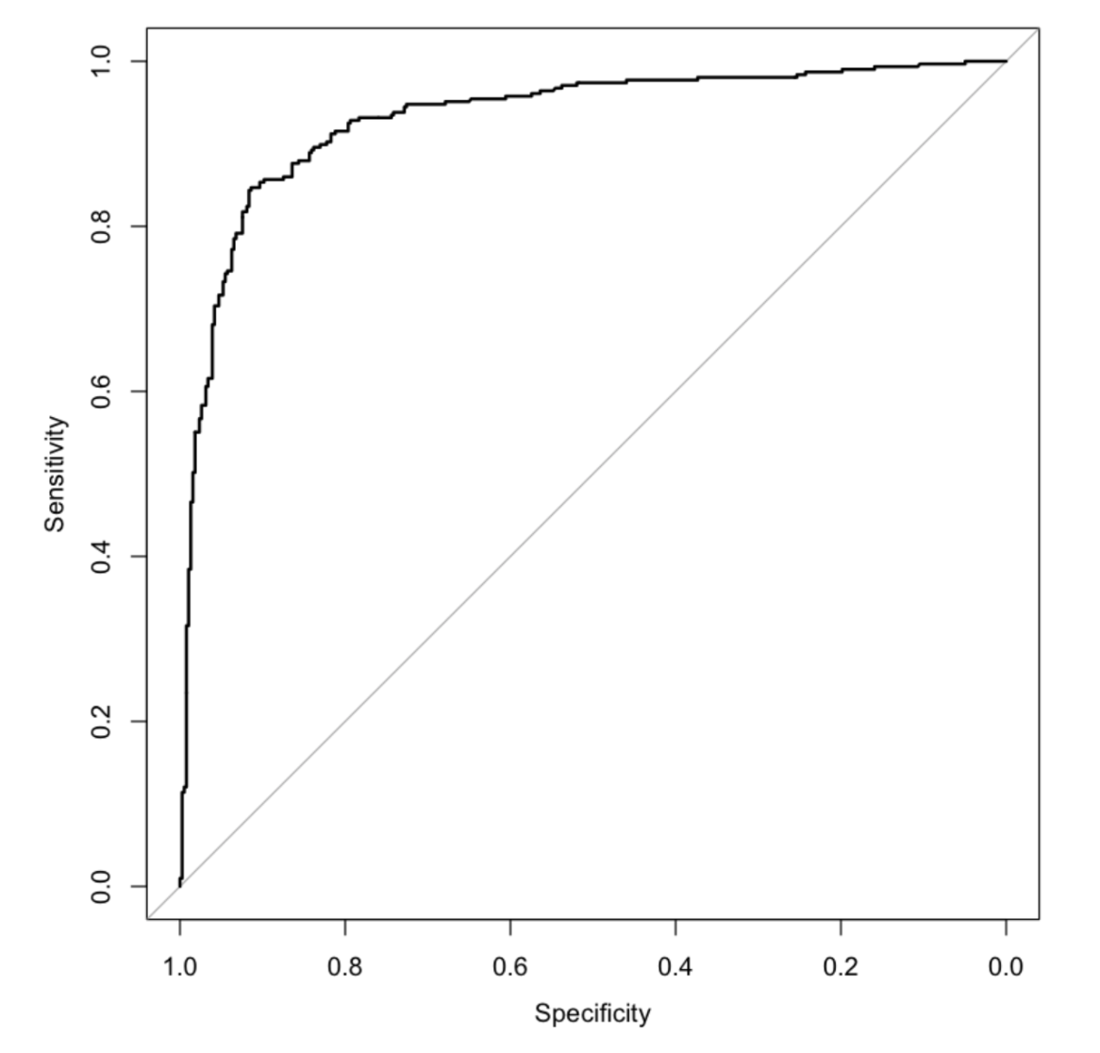
Accuracy Metrics Used
ROC AUC Score was chosen as the main accuracy metric for this project since it provides a more reliable way to measure accuracy than F1_Score and is more commonly used evaluating Support Vector Machines.
The graphed line indicates model performance at various settings of threshold for class predictions
The area under such graphed line is used to assess model performance

Slide 11
Databases Used
DATABASE 1: Wine Quality Dataset has 11 training features and quality that ranges from 0 to 10. All of the training features are numeric which makes the data preparation easier. Quality column was modified to detect good quality ( ≥6) as 1 and poor quality (<6) as 0 which split the dataset targets approximately in half. The database contains 4898 Instances. [7]
DATABASE 2: Credit Approval Dataset has 15 training features and a binary approval decision. Only 6 training features in the dataset are numeric and the remaining 9 are classes. These classes were one-hot encoded which resulted in an increased amount of “new training features”. The dataset contains 690 instances.[8]
Both of the databases were found in UCI Machine Learning Repository:
https://archive.ics.uci.edu/ml/index.php

Slide 12
Software Tools Used
The project is presented in Jupyter Notebook using R - the language for statistical computing that was developed in University of Auckland, New Zealand in 1992. R is widely used for statistics and data analysis and provides a broad range of packages with function implementations.
Packages used:
Caret - caret is a package developed to streamline the process for creating predictive models. It contains useful tools for data pre-processing, model training and variable importance selection. (https://cran.r-project.org/web/packages/caret/caret.pdf)
RandomForest - RandomForest package was developed to implement the relevant functions for working with Random Forest Classifiers including accuracy metrics and variable importance measures. (https://cran.r-project.org/web/packages/randomForest/randomForest.pdf)

Slide 13

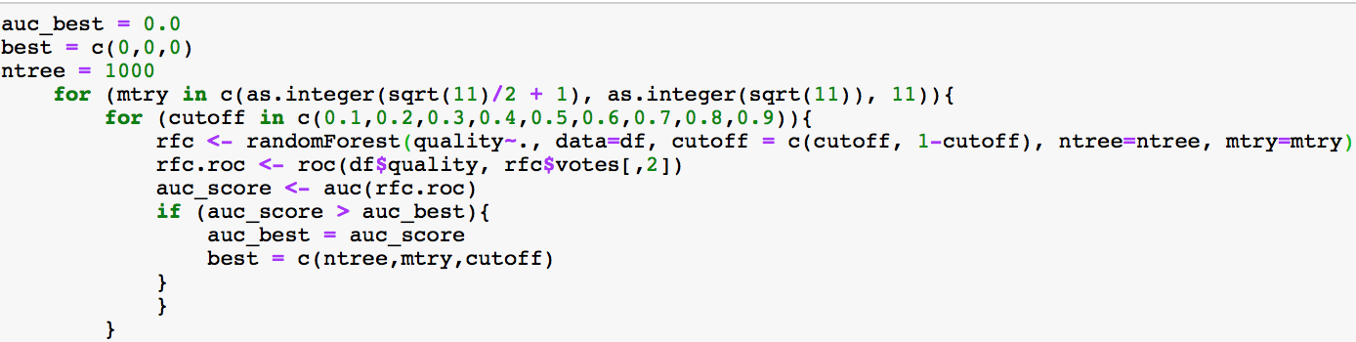
Software Procedures used. Random Forest.
caret and randomForest packages.
Grid Search Approach:
Determining Variable Importance:

Slide 14

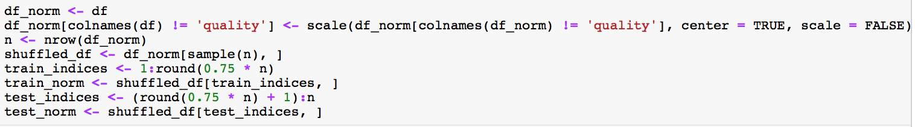
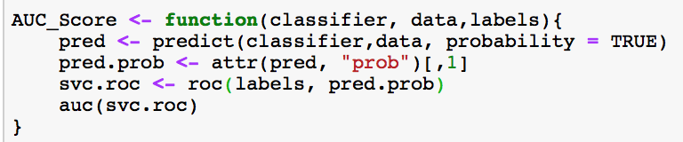
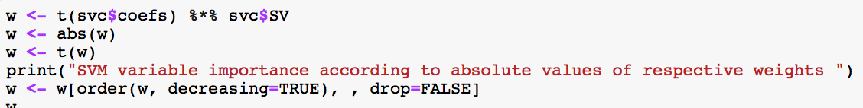
Software Procedures used. SVM. e1071 and pROC packages.
Data normalization and scaling:
Area Under Curve calculation:
Variable Importance calculation:

Slide 15
Results
After parameter optimization the following values were found to yield best accuracy result:
Random Forest:
SVM:
DB \Parameter | Optimal NTREE | Optimal MTRY | Optimal CUTOFF | Derived AUC Score
Wine Quality | 1000 | 2 | 0.7 | 0.91
Credit Approval | 1000 | 6 | 0.5 | 0.93
DB \ Parameter | Optimal C | Derived AUC Score
Wine Quality | 0.01 | 0.81
Credit Approval | 0.022 | 0.91

Slide 16
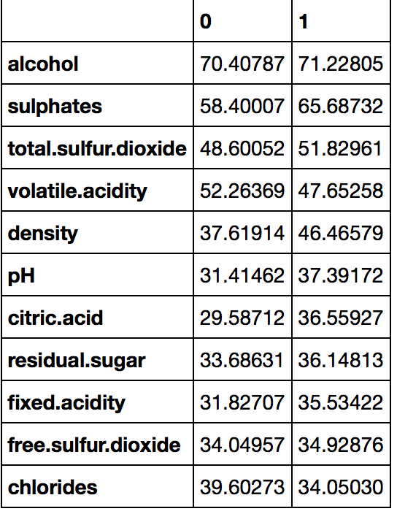
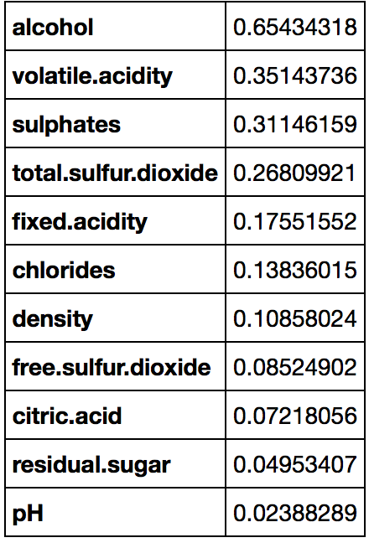
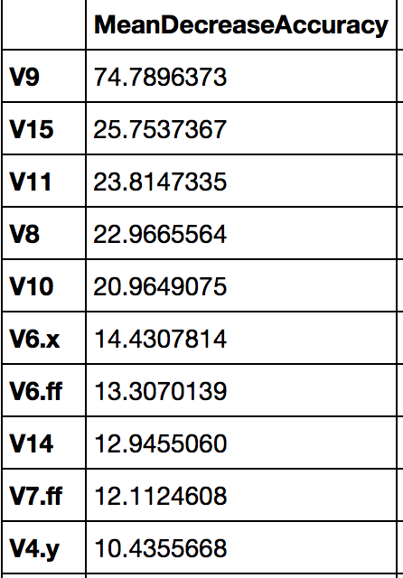
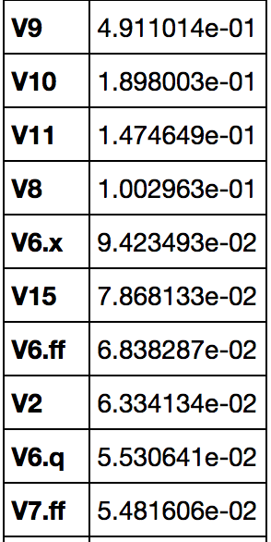
Results
The most important features in each dataset were identified for each ML method. The derived results showed some degree of similarity between two different methods:
Wine Quality DB: Credit Approval DB:
Random Forest MDA SVM |w_{j}| Random Forest MDA SVM |w_{j}|

Slide 17
Results
After obtaining top important features for two different machine learning models on two different databases, new models were trained based on only half of the most important features of the dataset. The following results were obtained:
Database \ ML method | RandomForest | SVM
Wine quality DB | 0.91 AUC Score | 0.81 AUC Score
Credit approval DB | 0.93 AUC Score | 0.91 AUC Score
Wine quality DB (top ranked ½ of features) | 0.83 AUC Score | 0.68 AUC Score
Credit approval DB (top ranked ½ of features) | 0.93 AUC Score | 0.90 AUC Score

Slide 18
Discussion
We showed that both Random Forest and Support Vector Classifiers can produce good classification results for the selected databases. In both datasets Random Forests slightly outperforms SVM.
We showed that feature importance can be estimated using MDA values for Random Forests and absolute values of relative weights for SVM with features normalized to 0 mean and unit variance. While the feature importances for different classifiers are not exactly the same, they do possess a considerable degree of similarity.
We then showed that for both of the ML methods the datasets cut in half with only most important features left can produce almost same results as the full datasets.
This confirms the results obtained in “Improving the explainability of Random Forest classifier - user centered approach”[2] which also found that a small amount of features is required to make a meaningful ML prediction.
In many cases using less features for ML pipeline can reduce operation costs, but it also makes ML process more intuitive and easier to understand.

Slide 19
Acknowledgements
I would like to thank Professor D. Petkovic for supervising this Study and providing great insight on the use of Machine Learning in real business applications as well as guiding me through the theoretical background of studied Machine Learning methods.
Additional thanks to Dr. L Buturovic for providing help with understanding Support Vector Machines in theory and practice.

Slide 20
References
[1]Buturovic L, Wong M, Tang GW, Altman RB, Petkovic D (2014) High Precision Prediction of Functional Sites in Protein Structures. PLoS ONE 9(3): e91240. https://journals.plos.org/plosone/article?id=10.1371/journal.pone.0091240
[2]Petkovic, Dragutin et al. “Improving the explainability of Random Forest classifier - user centered approach” Pacific Symposium on Biocomputing. Pacific Symposium on Biocomputing vol. 23 (2018): 204-215.https://psb.stanford.edu/psb-online/proceedings/psb18/petkovic.pdf
[3]Petkovic, Dragutin & Kobzik, Lester & Re, Christopher. (2018). Machine learning and deep analytics for biocomputing: call for better explainability. 623-627. https://psb.stanford.edu/psb-online/proceedings/psb18/wkshop-machine.pdf
[4]Olson, Randal & La Cava, William & Mustahsan, Zairah & Varik, Akshay & Moore, Jason. (2018). Data-driven advice for applying machine learning to bioinformatics problems. 192-203. https://psb.stanford.edu/psb-online/proceedings/psb18/olson.pdf
[5]Chang, Yin-Wen & Lin, Chih-Jen. (2008). Feature ranking using linear SVM. Journal of Machine Learning Research - Proceedings Track. 3. 53-64. http://proceedings.mlr.press/v3/chang08a/chang08a.pdf
[6]Breiman L (2001) Random Forest. Machine Learning 45 https://link.springer.com/article/10.1023/A:1010933404324
[7]Wine Quality Dataset: https://archive.ics.uci.edu/ml/datasets/Wine+Quality
[8]Credit Approval Dataset: https://archive.ics.uci.edu/ml/datasets/Credit+Approval
[9]Caret package references: https://cran.r-project.org/web/packages/caret/caret.pdf
[10]RandomForest package references: https://cran.r-project.org/web/packages/randomForest/randomForest.pdf
[11]Project code and relevant data: https://github.com/renowator/ML_Explainability_Study.git

Slide 21
Thank you for your interest!

